Slide 1
Reach for the Star: Integrated Supports for a Good Life
People First of Missouri Statewide Self-Advocacy Conference, April 2017

Slide 2
Welcome
Introductions
Notes:
Introduce speakers and if the group is small enough, do introductions with the participants

Slide 3
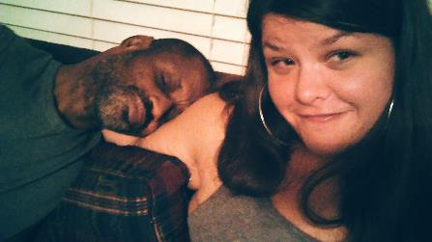
Nice to meet you
I’m Rachel
Communications & Design Specialist
Missouri Family to Family at the UMKC IHD, UCEDD
MPA with an emphasis in Nonprofit Management
Barbara’s granddaughter
Calvin’s friend and advocate

Slide 4
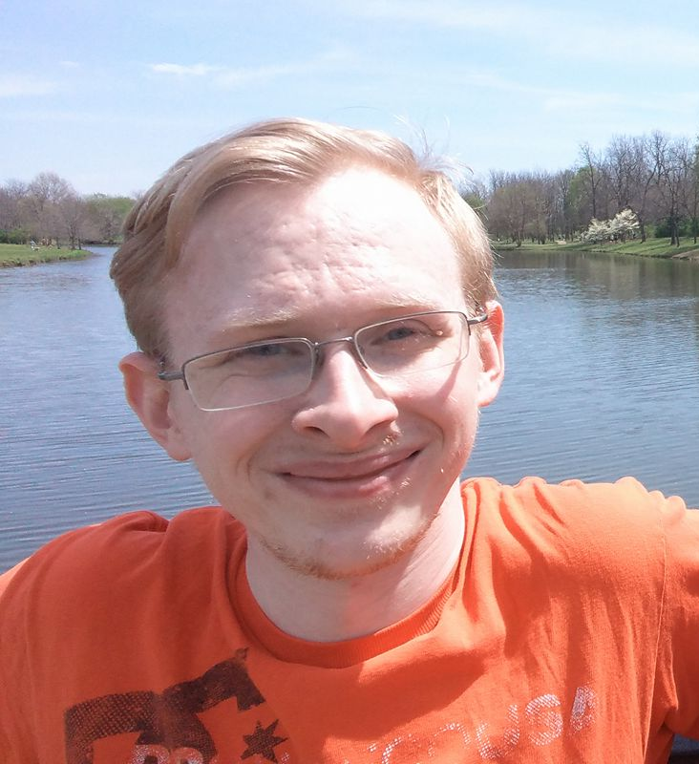
Nice to meet you
I’m David
Advocacy Specialist at the Springfield Regional Office
Likes to write
Artist
Creative soul

Slide 5
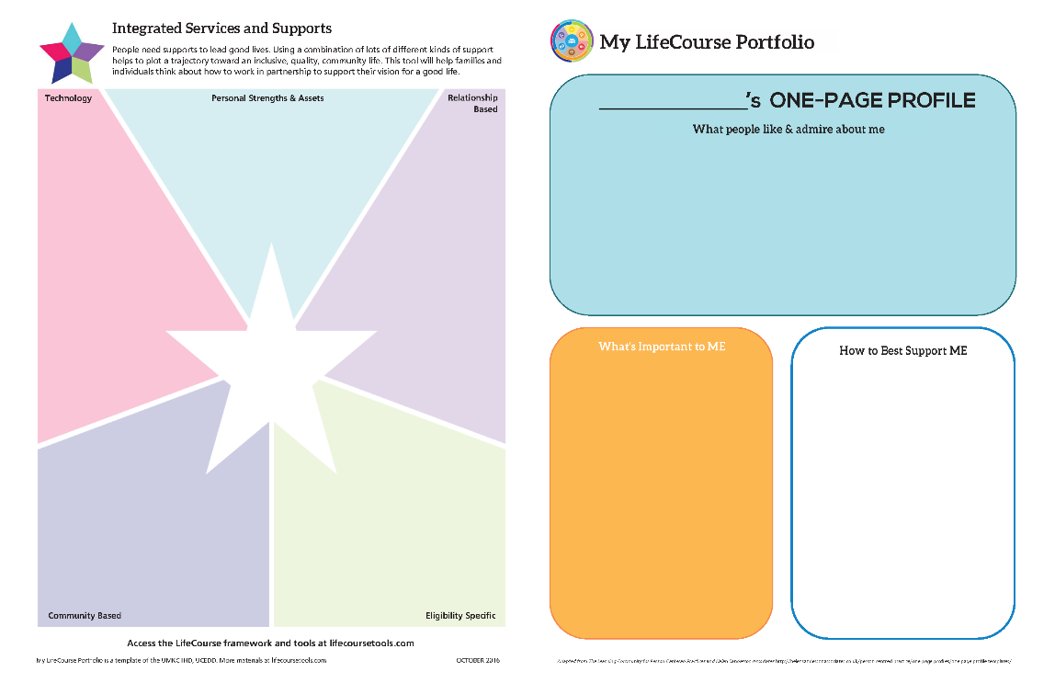
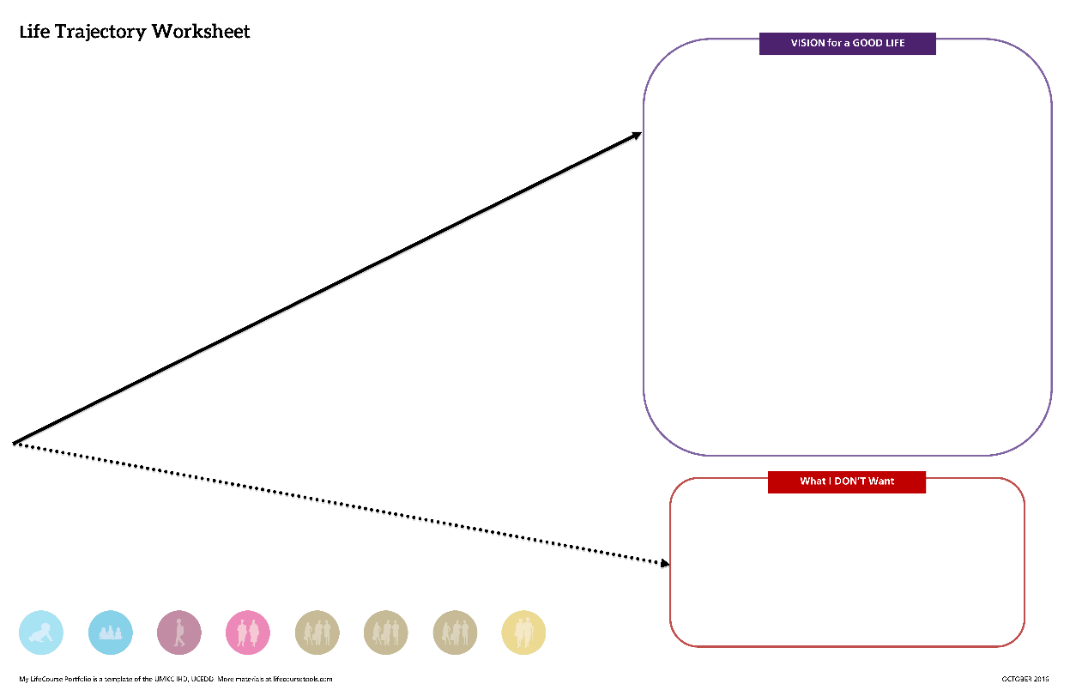
Last time we…
LifeCourse Overview
Started your LifeCourse Portfolio
Notes:
IF you came to our presentation yesterday, we started our LifeCourse Portfolios. We did our one-page profiles.. And we talked about having a vision for a good life and looked at our life experiences, both good and bad that have helped us get where we are today.

Slide 6
Goals for this Session
Learn all about the Integrated Supports Star.
Map your current (and needed) supports using the Integrated Supports Star.
Practice using the LifeCourse portfolio to advocate for your good life.
Notes:
Having a vision is very important. But nobody can do anything alone. We all use supports to make our daily lives possible.
How many of you used an alarm clock to wake up this morning?
How many of you use the bus to get around when you’re at home?
How many of you have a PCA or support staff?
These are just some examples of supports people use.
So today, we are going to focus on the Integrated Supports Star.

Slide 7
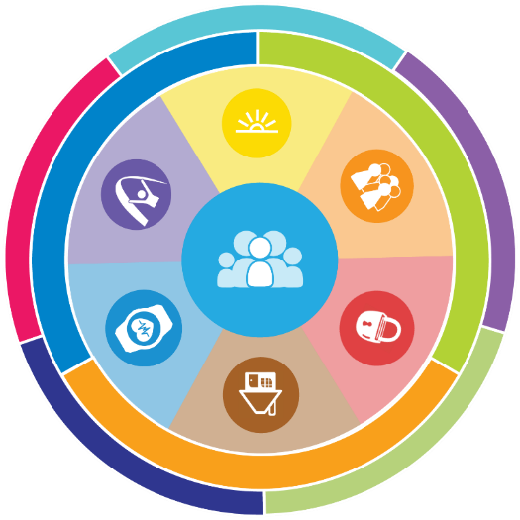
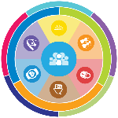
Charting the LifeCourse Framework
Quick Recap - Building Blocks
Notes:
RACHEL:
So, now let’s get started learning about the LC Framework.

Slide 8
Focus on “ALL”
25%
100%
75%
National % Receiving State DD Services
All 4,900,000 people with developmental disabilities
Only 1 in 4 people with DD receive services
** Based on national definition of developmental disability with a prevalence rate of 1.49%
Notes:
RACHEL: The LifeCourse Framework was made for ALL people.
You might not know this but a lot of your friends might not be getting the same supports and services that you are.
When we are talking about all people, we’re talking about all 4,900,000 people with developmental disabilities. A lot of times when we talk about what people with disabilities need, we’re only focusing on those who receive paid services from their state system.
Only 25% of all people with developmental disabilities in America receive paid services. That means only 1 person in 4 with a DD actually receives paid services!
This specific training was developed for people receiving services from the Division, the green part of the triangle

Slide 9
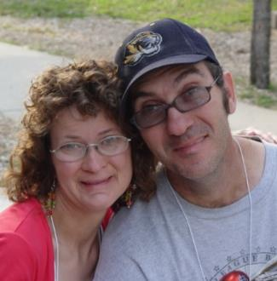
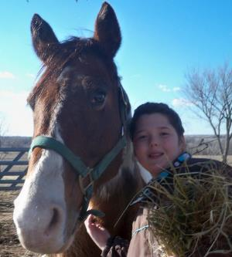
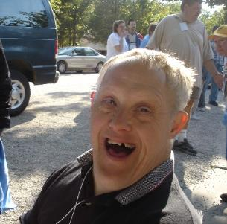
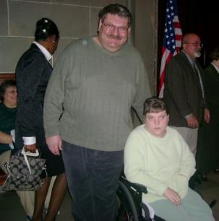
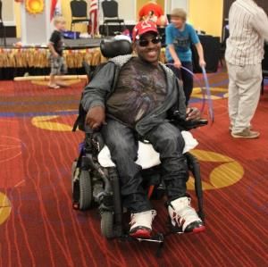
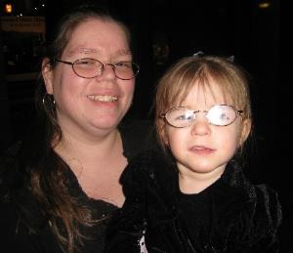
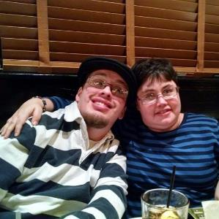
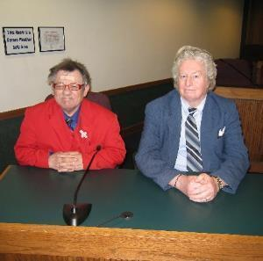
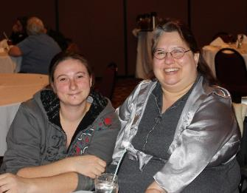
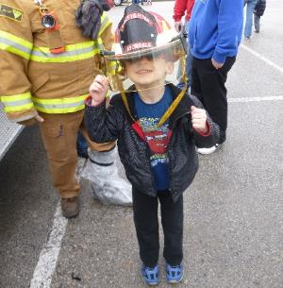
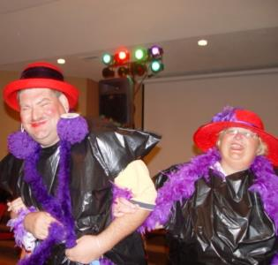
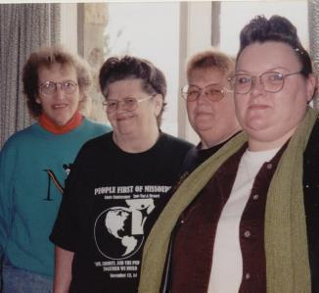
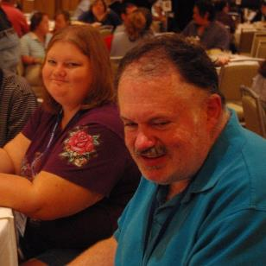
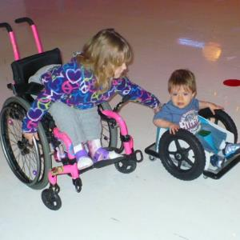
All people have the right to live, love, work, play and pursue their dreams in their community.
Notes:
This is our core belief that guides all of the work that we do at Missouri Family to Family.
Let’s all read the blue box. All people have the right to live, love, work, play and pursue their dreams in their community.

Slide 10
Notes:
RACHEL:
Now, we are going to build the LifeCourse circle. To us, the LifeCourse circle represents the good life.
We start with the person-

Slide 11
Notes:
RACHEL:
Part of the good life is being part of a family. All people have a family (whether you like them or not, or even if you don’t see them often or at all).
YOU define who your family is. It could be people you are related to biologically or just your friends and neighbors.

Slide 12
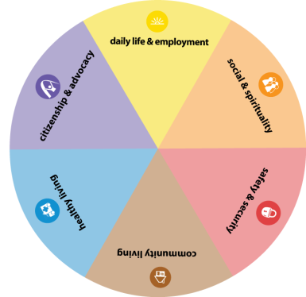
Notes:
RACHEL:
How many times have you heard “healthy” and “safe?” How often are you asked if you are actually happy? If you like where you live, who you live with, and what you do during the day?
We believe that there is more to having a good life than just being healthy and safe.
We believe the conversation needs to change so that people can have a really good life. Instead of checking boxes on a list like water temperature and making sure all the right forms, we need to start looking at things with a new lens and asking things like
Will I have a job?
Where will I live?
Who will love and look out for me?

Slide 13
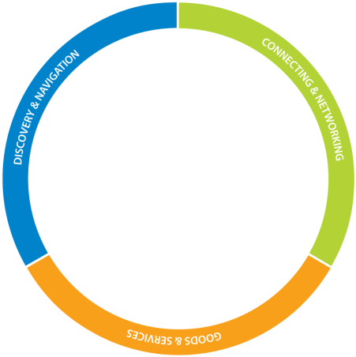
Notes:
RACHEL:
Part of having a good life is making sure all of our needs are met. We KNOW that people and their families need more than goods and services. We aren’t saying that goods and services aren’t important. We are saying that families have additional needs that need to be met.
The first bucket is Information (or Discovery and Navigation). Sometimes, we don’t need anything but information about a topic so we can make a decision or simply know what’s going on.
The second bucket is Connecting. We have learned that people and family members benefit from talking to others who have in their shoes and can relate to what they might be going through at that time.
Finally, Goods and Services are those things that we connect with to make our daily lives possible. They can be as simple as your alarm clock or as complex as applying for formal services.
We always want to make sure we are filling all of our buckets, not just dropping everything into the goods and services bucket.

Slide 14
Notes:
The final part of the LifeCourse circle is Integrated Supports.

Slide 15
Notes:
We ALL access a variety of supports to make it through our daily lives – we draw on our own knowledge and skills, we get help from other people, we use technology, and we get services and supports in the community. In order to have a good life, we need to have lots of different types of supports.
This is the Integrated Supports Star. The Integrated Star represents getting the support we need to have a good life.
We are going to learn more about the star in a hot second.

Slide 16
Notes:
SAY:
The line pointing toward the LifeCourse Circle is the trajectory.
A trajectory is the path your life takes toward the future. It can change based on the choices you make, other peoples’ actions, and events that might be out of your control. The goal is the good life, so we want the trajectory to go up.

Slide 17
Notes:
And finally, we want a good life for all people, no matter what age or stage they might be facing!

Slide 18
NOTHING ABOUT US WITHOUT US!
People with I/DD and their families need seats at the table so they can be involved in the changes we want to see and make our vision for a good life for all possible
Notes:
The last thing you need to know about the LifeCourse is we believe that people and their families need seats and a voice at the table so they can be involved in the decisions that affect their lives! Nothing about us without us!

Slide 19
Integrated Supports
For a Good Life
Notes:
So now, we’re going to learn all about Integrated Supports and the Star!

Slide 20
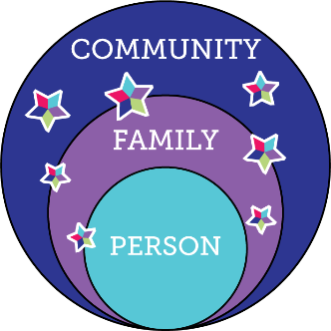
Integrated Services and Supports
Notes:
If you came yesterday, you remember our vision for people with DD and their families having good lives is being part of their families and communities with the supports and services they need, when and where they need them.
Now, we are going to teach you about each part of the star.

Slide 21
Integrated Supports
Notes:
PERSONAL STRENGTHS & ASSETS
What can you personally bring to the table?
Personality traits
Skills or training that you have
Belongings that own or things you have access to
What are some examples of personal strengths and assets you have or can think of?

Slide 22
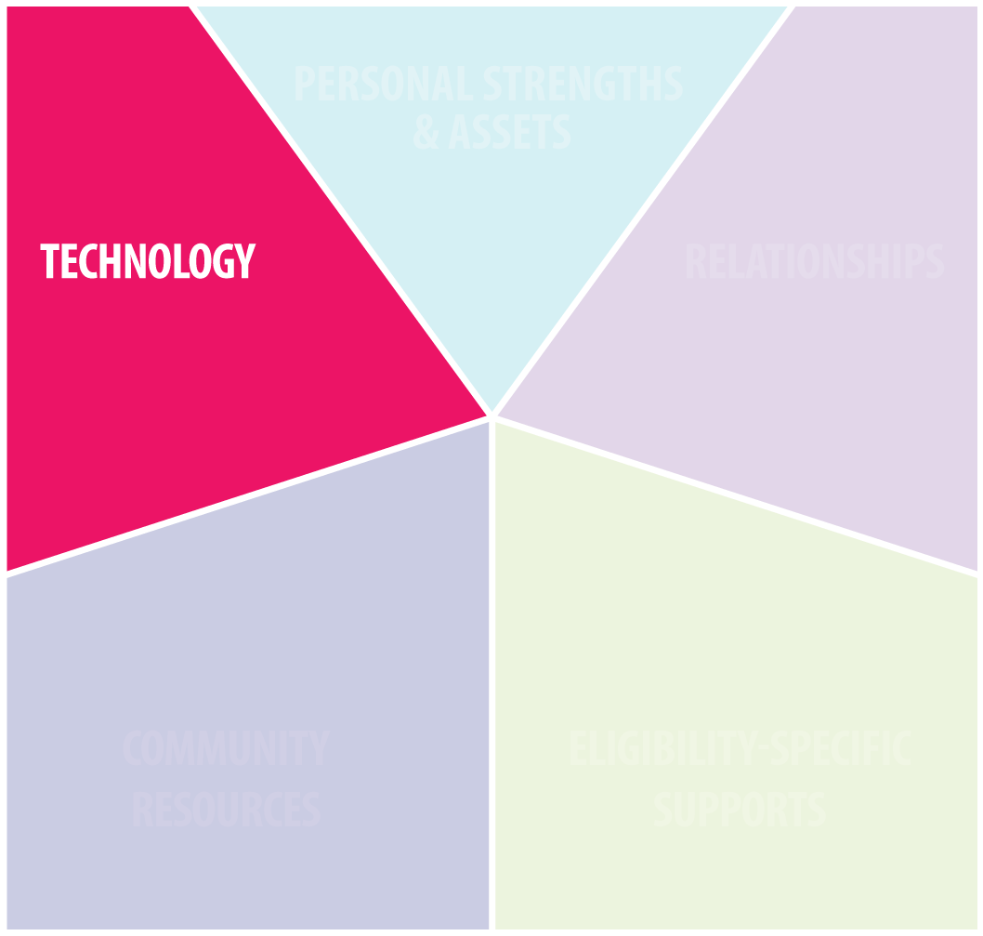
Integrated Supports
Notes:
The next part of the star is TECHNOLOGY
How can technology help you be more independent?
Simple machines like toasters, alarm clocks
Smartphones
Assistive technology
Internet and computers
What are some examples of technology that you use to help you get through your day?

Slide 23
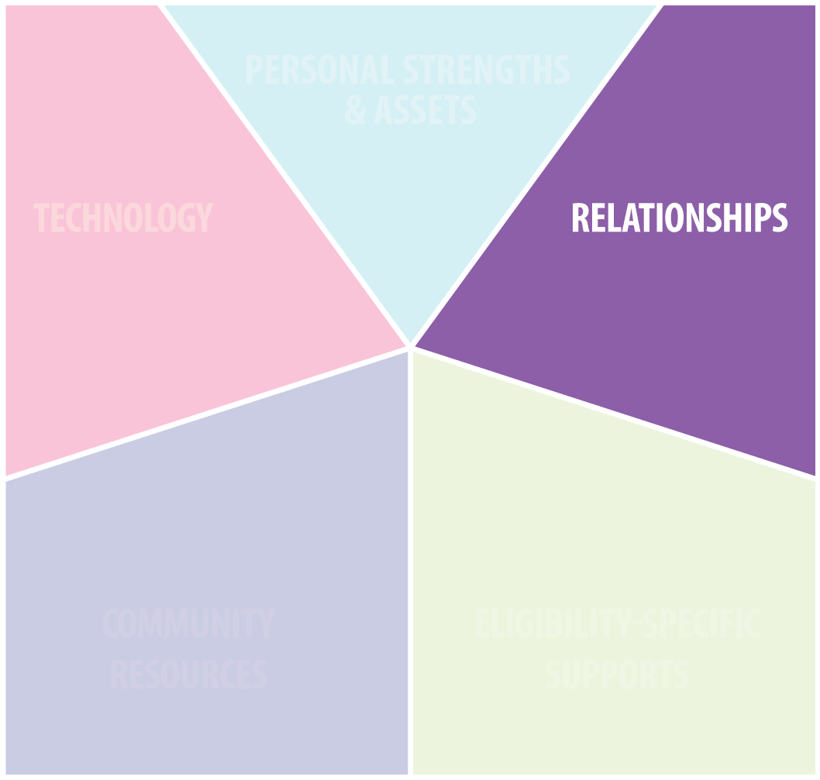
Integrated Supports
Notes:
The next part of the star is RELATIONSHIPS
Who do you have in your life that cares for you and can help you?
Family
Friends
Close personal relationships (like your neighbor, boss, pastor coworkers, etc)
Who is important to you in your life?

Slide 24
Integrated Supports
Notes:
COMMUNITY RESOURCES
Businesses, places, and things anyone can access where you live:
School
Library
Park
Police station
Hospital
Church
Grocery Store
Where are some places you know where everybody knows your name?

Slide 25
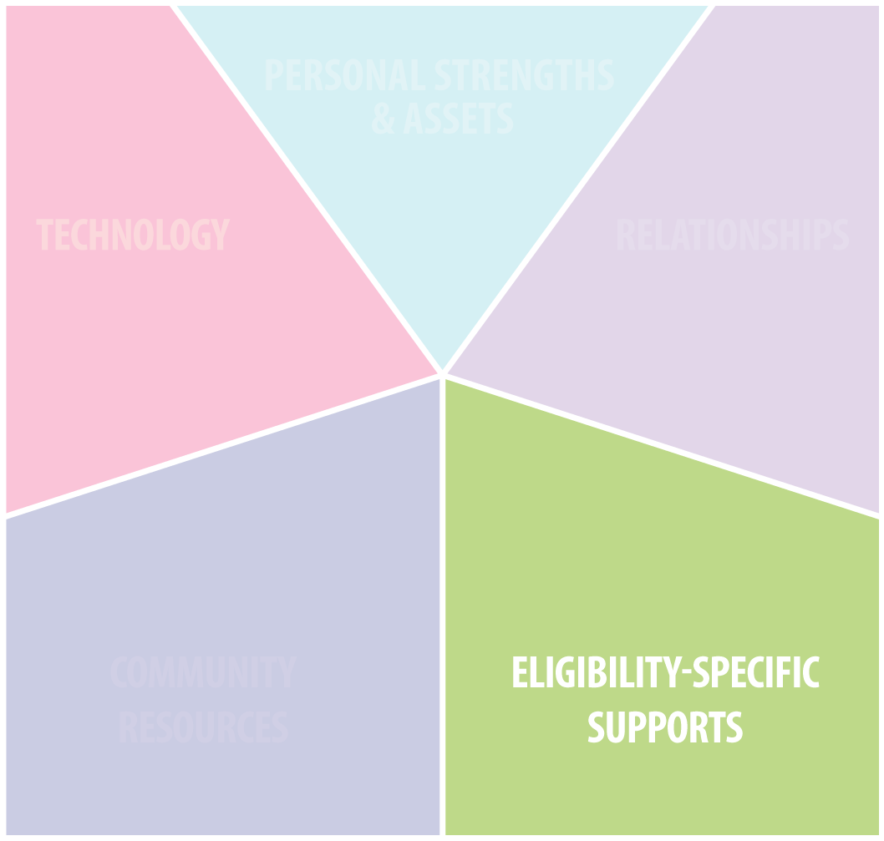
Integrated Supports
Notes:
ELIGIBILITY SPECIFIC OR PAID SUPPORTS
Things you have to have a diagnosis, certain income, or other qualification (like age, gender, or race) for
Food stamps
Housing Voucher
DD Services
Medicaid
Medicare
What are some examples of services you might qualify for based on a label?

Slide 26
Integrated Supports
Notes:
INTRODUCE BASKETS
Remember, to have a good life, we have to use integrated supports.
We have to use all part of the star.
David – spreads his eggs out across his baskets
Rachel – puts all her eggs in the green basket

Slide 27
Integrated Supports Jeopardy!

Slide 28
Contestant #1

Slide 29
Who can help me find a job or start my own business?

Slide 30
Who can help me find a job or start my own business?
PERSONAL STRENGTHS & ASSETS
Sense of humor
Can tie shoelaces
Can say alphabet backwards
High School Diploma

Slide 31
Who can help me find a job or start my own business?
RELATIONSHIPS
A friend
Your dog
Your High School Gym Teacher
Spongebob Squarepants

Slide 32
Who can help me find a job or start my own business?
TECHNOLOGY
Youtube
Monster.com
Farmville
Angry Birds

Slide 33
Who can help me find a job or start my own business?
COMMUNITY RESOURCES
The YMCA
The Krusty Krab
Missouri Career Centers
The Park

Slide 34
Who can help me find a job or start my own business?
ELIGIBILITY SPECIFIC
Environmental protection agency
Vocational Rehabilitation
Section 8
Homeland Security

Slide 35
Contestant #2
Notes:
Contestant #2

Slide 36
How can I make home modifications to live as independently as possible as I age?

Slide 37
How can I make home modifications to live as independently as possible as I age?
PERSONAL STRENGTHS & ASSETS
Lottery ticket
Money in savings
Dishwasher
Good at mopping the floor

Slide 38
How can I make home modifications to live as independently as possible as I age?
RELATIONSHIPS
Your five-year old niece
Your handy neighbor Joe
Squidward Tentacles
Your great, great, great aunt Eunice

Slide 39
How can I make home modifications to live as independently as possible as I age?
TECHNOLOGY
Xbox 360
MO Assistive Technology Show Me Loans
Your remote control
The Geek Squad

Slide 40
How can I make home modifications to live as independently as possible as I age?
COMMUNITY RESOURCES
Home remodeling company
Parks & Rec Department
Grocery store
Toys R Us

Slide 41
How can I make home modifications to live as independently as possible as I age?
ELIGIBILITY SPECIFIC
AARP
Food Stamps Office
Center for Independent Living
Navy recruiter’s office

Slide 42
Contestant #3
Notes:
Change circle- change where circle lands

Slide 43
How am I exploring or developing my interests or finding new ones?
Notes:
Add domain icon

Slide 44
How am I exploring or developing my interests or finding new ones?
PERSONAL STRENGTHS & ASSETS
Open mind
Bad attitude
Antisocial
Afraid to try new things

Slide 45
RELATIONSHIPS
How am I exploring or developing my interests or finding new ones?
Your neighbor
Your friends
Your family
All of the above

Slide 46
TECHNOLOGY
How am I exploring or developing my interests or finding new ones?
iPad
The dishwasher
Alarm clock
Candy Crush Saga

Slide 47
COMMUNITY RESOURCES
How am I exploring or developing my interests or finding new ones?
Parks & Rec Department
Miss Puff’s Driving School
Police station
Post office

Slide 48
ELIGIBILITY SPECIFIC
How am I exploring or developing my interests or finding new ones?
Department of Defense
Senior Center
HUD
Social Security office
Notes:
You guys are great at this! You are definitely pros at integrated supports!

Slide 49
Your LifeCourse Portfolio
Bringing it All Together
Notes:
RACHEL: Now, we are going to fill in your stars! What I want you to do is pull out your LifeCourse Portfolio.
Turn it over to the back so you have the Integrated Supports Star Worksheet in front of you.

Slide 50
David’s Integrated Supports Star
Good writer
Mustang convertible
Job > income
Apartment
Creative
Bicycle

Slide 51
Your Integrated Supports Star
Fill out your own personal strengths and assets

Slide 52
David’s Integrated Supports Star
Smartphone
Computer
Fitbit
Microwave
Kindle tablet
Glasses

Slide 53
Your Integrated Supports Star
Fill out your own technology part of the star

Slide 54
David’s Integrated Supports Star
Michael
Nathan
Mom and dad
Coworkers

Slide 55
Your Integrated Supports Star
Now fill in your relationships in the purple part of the star!

Slide 56
David’s Integrated Supports Star
Library Center
Price Chopper
Bank of America
Wendy’s

Slide 57
Your Integrated Supports Star
Now fill in your relationships in the blue part of the star!

Slide 58
David’s Integrated Supports Star
Voc Rehab

Slide 59
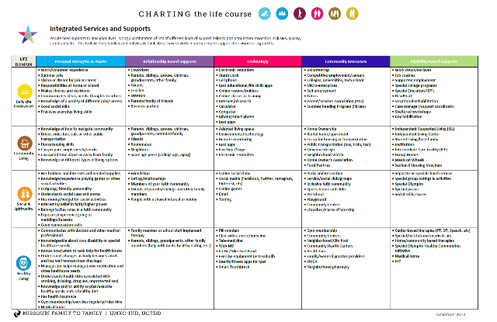
Your Integrated Supports Star
Now fill in what you’re eligible for in the green part of the star!
Need help? Use the Integrated Options LifeCourse tool!

Slide 60
Using your LifeCourse Portfolio
to Get to your Good Life
Notes:
Even just putting on paper can help you become more aware of the supports that you have or the supports that you might need- you might have noticed that one of your parts of the star is kind of empty.

Slide 61
How to use your Integrated Star
Use the star to think through an everyday problem (ie: dinner)
Use the star to help you think who could help you accomplish a goal (short term or long term)
Use the star to help you see where you might need to build supports
Use the star at your planning meeting to decide who could help you with your goals/outcomes

Slide 62
Wrapup

Slide 63
Reflection
What have we learned?
What are your next steps?
What was your favorite part?

Slide 64
LifeCourse Drawing

Slide 65
Rachel Hiles hilesr@umkc.edu
Notes:
If you need to get in touch with me……. Thank you for coming!

Slide 66
David Forbes david.forbes@dmh.mo.gov
Notes:
If you need to get in touch with me……. Thank you for coming!

Slide 67
If you need help along the way….
(800) 444-00821 | mofamilytofamily.org

Slide 68
Visit us online at lifecoursetools.com

